Slide 1
MS4 Modeling Environment (MS4 Me)
System Entity Structure based DEVS Modeling and Simulation environment
July, 2015
MS4 Systems, Inc. RTSync Corp.
4425 E Agave Rd Suite 106
Phoenix, AZ 85044, USA
www.ms4systems.com
Arizona Center for Integrative Modeling and Simulation ( ACIMS )
www.acims.asu.edu

Slide 2
Objectives
Background and Introduction
Brief overview of the System Entity Structure (SES) and related concepts
Tour of the MS4 Modeling Environment (MS4 Me)

Slide 3
Background
RTSync Corp. and MS4 Systems, Inc.
Spin off of Arizona Center for Integrative Modeling and Simulation (ACIMS) at the University of Arizona and Arizona State University
Founded in 2004 and 2012 respectively, as an advanced modeling and simulation consultant company
http://acims.asu.edu
http://www.rtsync.com
http://www.ms4systems.com, info@ms4systems.com, support@ms4systems.com
MS4 Modeling Environment (MS4 Me)
Under development for over four years
Commercial release, January 2013
Free trial version available

Slide 4
DEVS Modeling & Simulation Approach
DEVS (Discrete Event System Specification) formalism provides an engine for advanced Modeling & Simulation (M&S) technology to support “build and test”.
DEVS evaluates different design alternative of a system, where information of system structure as well as component behavior can be implemented in an integrated simulation environment.
Structural Description
Contains the hierarchical structure information of target system
Combine structure and component behavior
System
Generate Simulation
Session
Behavior Description
Contains the behavior information of system component

Slide 5
Structural Description : System Entity Structure (SES)
The System Entity Structure (SES) is a formal framework to represent the elements of a system (or world) and their relationships in hierarchical manner.
Structural Description
System
Combine structure and component behavior
Generate Simulation
Session
Behavior Description
Aspects represent ways of taking things apart into more detailed ones and labeled decomposition relation between the parent and the children
System Entity Structure
A
Specialization categorizes things in specific forms and is a labeled relation that expresses alternative choices.
B
C
B1
B2
D
E
F
DS
F1
F2
F3
Multi-aspects are aspects for which the components are all of the same kind.
Pruning
Pruning:
An operation to cut off structure in a SES that is not needed to meet particular problem specifications.
Pruned Entity Structure 1
Pruned Entity Structure 2
A
A
B:B2
C
B:B1
C
D
E
F:F1
D
E
F:F3
D
D
D
D
D
D

Slide 6
System Development Process (I)
DEVS simulation session is created by combining pruned entity structure and DEVS models.
System Entity Structure
Car
Engine
Transmission
Chassis
Gasoline Engine
Electrical Engine
Natural
Gas Engine
Automatic
Transmission
Manual
Transmission
Front
Wheel
Chassis
Rear
Wheel
Chassis
4 Cyl
Engine
6 Cyl
Engine
8 Cyl
Engine
Pruning
Pruned Entity Structure 1
Pruned Entity Structure 2
Car 1
Car 2
Engine:
Gasoline
Engine
Transmission: Automatic
Transmission
Chassis:
Rear Wheel
Chassis
Engine:
Electrical
Engine
Transmission: Manual
Transmission
Chassis:
Rear Wheel
Chassis
6 Cyl
Engine

Slide 7
System Development Process (II)
After pruned entity structure and models are combined, the ‘Experiment Frame’ initiates simulation session
Experiment Frame (EF) consists of
Generator: Send series of input data to model based on simulation scenario
Analyzer: Collect output of models to analyze the result
SES Base
System Design Alternative 1
Engine:
Gasoline
Engine
Car 1
Car 1
Car 1
Transmission: Automatic
Transmission
Chassis:
Rear Wheel
Chassis
Car 1
Engine:
Gasoline
Engine
Transmission: Automatic
Transmission
Chassis:
Rear Wheel
Chassis
Car 1
Experiment Frame
6 Cyl
Engine
Engine:
Gasoline
Engine
Transmission: Automatic
Transmission
Chassis:
Rear Wheel
Chassis
Car 1
6 Cyl
Engine
Engine:
Gasoline
Engine
Transmission: Automatic
Transmission
Chassis:
Rear Wheel
Chassis
6 Cyl
Engine
6 Cyl
Engine
Engine:
Gasoline
Engine
Transmission: Automatic
Transmission
Chassis:
Rear Wheel
Chassis
Engine:
Gasoline
Engine
Transmission: Automatic
Transmission
Chassis:
Rear Wheel
Chassis
6 Cyl
Engine
Generator
Analyzer
State
State
State
State
External
Transition
State
State
State
State
State
Internal
Transition
External
Transition
State
State
State
State
State
Internal
Transition
External
Transition
State
State
State
State
State
Internal
Transition
External
Transition
State
State
State
State
State
Internal
Transition
State
State
State
State
Model Base
6 Cyl
Engine
time advance
time advance
time advance
output
time advance
output
output
output
External
Transition
State
State
State
State
State
Internal
Transition
External
Transition
State
State
State
State
State
State
State
Internal
Transition
External
Transition
State
State
State
State
State
State
State
Internal
Transition
External
Transition
State
State
State
State
State
State
State
Internal
Transition
State
State
time advance
output
time advance
output
time advance
output
time advance
output
External
Transition
State
State
State
State
State
State
State
Internal
Transition
External
Transition
State
State
State
State
State
State
State
Internal
Transition
External
Transition
State
State
State
State
State
State
State
Internal
Transition
time advance
output
time advance
output
time advance
output
External
Transition
State
State
State
State
State
State
State
Internal
Transition
External
Transition
State
State
State
State
State
State
State
Internal
Transition
External
Transition
State
State
State
State
State
State
State
Internal
Transition
time advance
output
time advance
output
time advance
output

Slide 8
Behavior Description : DEVS Model
DEVS model describes the behavior of a component based on state transition that displays discrete event activity of system.
Structural Description
System
Combine structure and component behavior
Generate Simulation
Session
Behavior Description
State2
State3
Input
External
Transition
State1
State4
Internal
Transition
State7
State5
State6
time advance
output
Output
DEVS Atomic Model

Slide 9
Behavior Description : DEVS Model
Multiple model constructs a bigger coupled model, where each model interfaced via input and output port.
Structural Description
System
Combine structure and component behavior
Generate Simulation
Session
Behavior Description
Coupled Model
State
External
Transition
State
State
State
Internal
Transition
Output
State
State
State
Input
time advance
Atomic Model
output
Coupled Model
External
Transition
State
State
State
Internal
Transition
State
State
State
State
External
Transition
State
State
State
Internal
Transition
time advance
State
State
State
Atomic Model
output
State
time advance
output
Atomic Model
State
State
External
Transition
State
State
State
Internal
Transition
State
State
time advance
output
Atomic Model

Slide 10
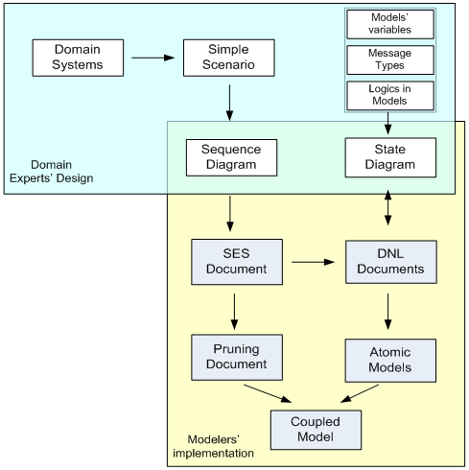
Modeling and Simulation Methodology with MS4 Me
MS4 Me provides Two Level Designs
High level design for domain expert
Low level design for modeling expert
High level design
Simple Scenario
Sequence Diagram
State Diagram
Message types interact between models
Variables used in a model
Logics used in a model
Low level design
Converting logics to computer language codes
Code tag block

Slide 11
MS4 Modeling Environment
Software Tool for DEVS Modeling and Simulation
Based on Java and Eclipse RCP environment
Top down modeling methodology
Sequence Diagram Designer generates a SES file and DNL files
Bottom up modeling methodology
State Diagram Designer generates DNL files
Features
Highlight keywords capability when editing SES and DNL files
Automatic converting DNL files to Atomic Java Models
Tree Viewer for a SES file
Pruning process from Pruning SES document to generate coupled Java models
Launch page to help directly access to the SES and PES files
Support dynamic structure model
Graphing capability

Slide 12
Launch Page
New Project creates a project
Sequence Diagram opens/creates SES files in Sequence Diagram Designer
Atomic Model opens/creates DNL files in text editor or State Diagram Designer
System Entity Structure (SES) opens/creates SES files in text editor
Prune a SES Tree opens/creates PES files in text editor
View a SES Tree displays SES file in tree view
View Simulation opens models files and PES files in simulation viewer

Slide 13
Sequence Diagram and SES Document
Entity
Represent atomic or coupled model
Transition
Define model’s behavior
Message Passing
Sequence Diagram Designer
Converting designs
to SES document
Converting SES document
To Sequence Diagram
Root Entity (HelloExample)
Child Entity (MyWorld)
SES Document

Slide 14
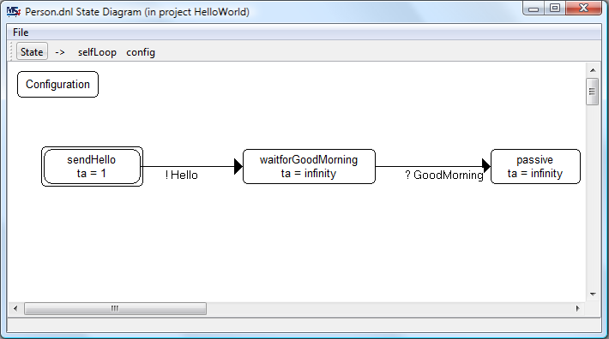
State Diagram and DNL Document
Configuration
Define variables and data types
Contain additional information
State
Name and Time Advance
Initial State (Double rectangles)
Transition (Event)
External Event (?)
Internal Event (!)
Tag blocks for Java codes
State Diagram Designer
Convert State Design
to DNL Document
Convert DNL Document
to State Design
DNL Document

Slide 15
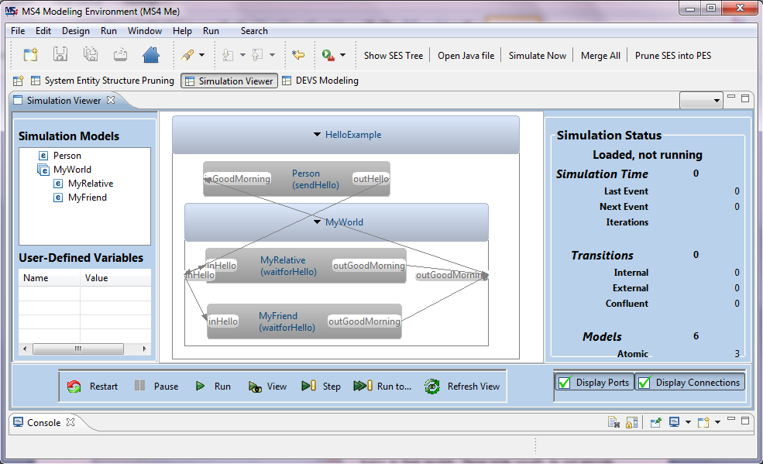
Simulation Viewer
Tree View of Simulation Models
Simulation Status
List of Variables in the selected model
Simulation Controller
Display Ports’ names and connections

Slide 16
Markov Modeling Facility in MS4 Me
Markov Modeling facility in MS4 Me offers an easy-to-use set of tools to develop Markov models
as full-fledged DEVS models
able to be integrated with other DEVS models
makes it much easier to develop probabilistic/stochastic DEVS models
automates a lot of the development tasks otherwise done manually
Raises the power of model development to a new level of speed and confidence
Unparalleled in all other commercial and academic tools on the market
You will be able to develop families of DEVS models for cutting edge challenging areas such as
Systems of Systems,
agent-directed systems, and
DEVS-based development of Web/Internet of Things

Slide 17
MS4 Me 3.0 with Markov Modeling Facility helps you quickly and confidently …
Develop simulation models of systems and their components
Easily include both deterministic and probabilistic behaviors within the components and their interactions
Study the resulting system behavior with Monte Carlo simulation execution immediately available with the push of a button

Slide 18
Markov Modeling Facility in MS4 Me
Markov Modeling facility in MS4 Me offers an easy-to-use set of tools to develop Markov models
as full-fledged DEVS models
able to be integrated with other DEVS models
makes it much easier to develop probabilistic/stochastic DEVS models
automates a lot of the development tasks otherwise done manually
Raises the power of model development to a new level of speed and confidence
Unparalleled in all other commercial and academic tools on the market
You will be able to develop families of DEVS models for cutting edge challenging areas such as
Systems of Systems,
Agent-directed systems, and
DEVS-based development of Web/Internet of Things

Slide 19
New Markov Model Classes
Extends FD-DEVS (Finite Deterministic) and FP-DEVS capabilities (Finite Probabilistic)
Includes finite state Continuous Time Markov Model (CTM),
Discrete Time Markov chain (DTM) and the
Markov Matrix (MarkovMat) classes
CTM Models represent complex systems at the level of individual actors
Multiple actors can be represented as a CTMs
With states and transitions
Inputs and outputs
Interact as atomic models within coupled models using coupling in the usual way

Slide 20
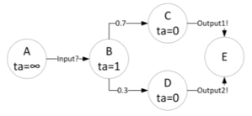
FPDEVS Example
Example
FPDEVS example which has one input (?) and two outputs (!).
‘B’ state can be changed to two states according to probability values at the internal transition stage.

Slide 21
References
For further information:
Published papers at SpringSim 2013, 2014, and 2015
Creating Suites of Models with System Entity Structure: Global Warming Example (Bernard P. Zeigler, Chungman Seo, Robert Coop and Doohwan Kim)
DEVS Modeling and Simulation Methodology with MS4Me Software Tool (Chungman Seo, Bernard P. Zeigler, Robert Coop and Doohwan Kim)
Books
Zeigler, Bernard P. Guide to Modeling and Simulation of Systems of Systems: User's Reference. Springer, 2013. (Available on Amazon)
Online
http://www.ms4systems.com
http://www.rtsync.com/
http://acims.asu.edu/
trial version available now at the MS4 Systems website

